Slide 1

A digital twin of a microbrewery—a case study investigating DT model integration and orchestration techniques
Preparation phase report for Master Project, 27-06-2022
Ander Lee
Department of Mathematics and Computer Science

Slide 2
Agenda
Introduction
State of the art
Related work
Problem description
Methodology
Preliminary outcomes
Project timeline
Notes:
Introduction 6
State of the art 2
Related work 6
Problem description 6
Methodology 2
Preliminary outcomes 8
Project timeline 2
Total 32 mins

Slide 3
Introduction
Background
Context
Digital twin
Applications
Challenges
Research topic
Case study: microbrewery

Slide 4
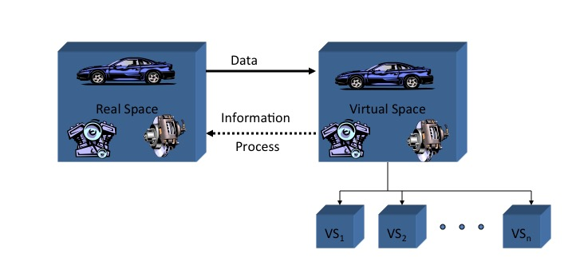
Background
The digital twin concept
A conceptual idea for PLM introduced by Michael Grieves in his 2002 presentation
Notes:
Systems are dual in nature, i.e., a system has a physical twin and a virtual twin.
The two sides are bound together via a data link. This link is bidirectional that it transfers data from the physical space to update the virtual space, and vice versa.

Slide 5





Context
Industry 4.0
Digital transformation
Improve the transfer of information across the value chain
Notes:
Allow stakeholders to share knowledge about the designs, conditions, and logistics of their products and operations through digital artefacts.

Slide 6


Context
Relation to MDSE:
Use models to support requirements, design, analysis and verification activities throughout the lifecycle.
DT take one step further to integrate cyber physical systems
Notes:
MDSE:
Holistic view ⇒ ‘system of systems’
System architecture: use models to support requirements, design, analysis and verification activities throughout the lifecycle.
Modelling: helps drive a consistent specification without significantly increasing costs as the system depth extends.
DT
capture the physical and functional descriptions. VEs monitor data from the PEs, use it to fulfil services which are requested by the user, and may optimize the PEs.
Benefit
Reduce maintenance costs during lifecycle.
Reduce errors and inconsistencies across multiple iterations.
Improve multi-disciplinary collaboration

Slide 7
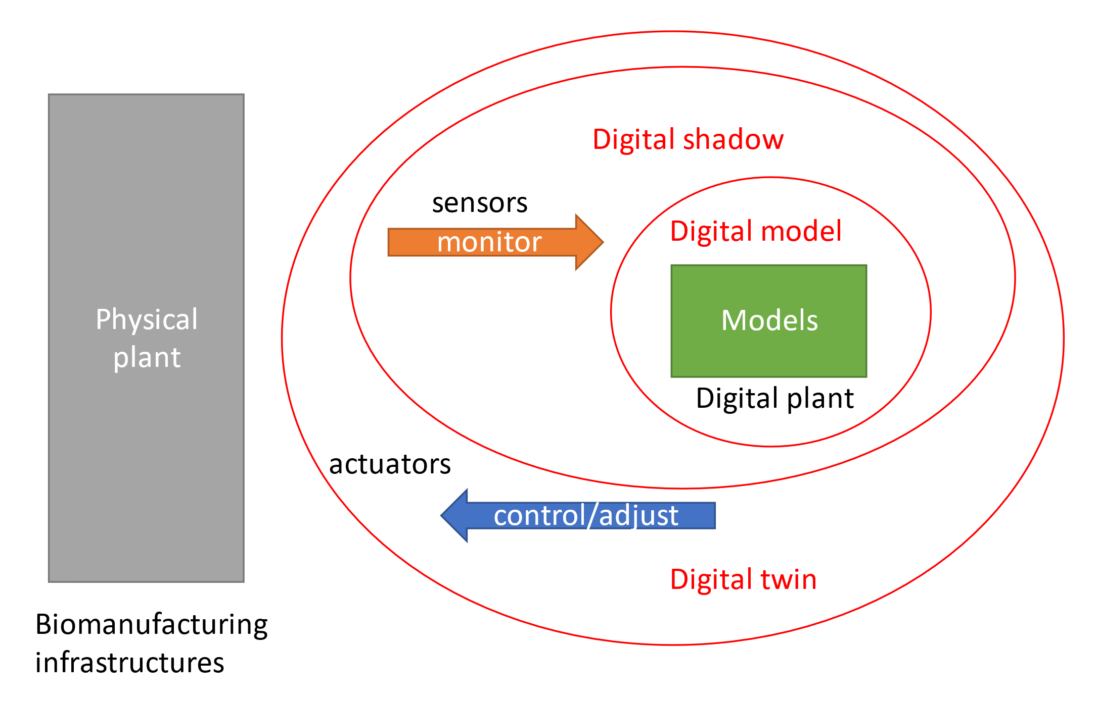

Digital twin
Classification
Notes:
Digital model: The virtual object does not involve data exchange with the physical object in an automated fashion. Hence the changes in one part have no direct effect on the other unless updates are performed manually.
Digital shadow: There exists an automated one-way data communication from the physical object to the virtual one.
Digital twin: An automation of bi-directional data exchange between the physical object and the virtual object. Changes made in the physical object will be reflected in the virtual object and vice versa.
In a simple control logic, once a computation produces feedback, the signal will be sent to the actuator to activate certain operations, whereas in a DT, the adjustment data that is sent back to the actuators from the model in the virtual world is meant to calibrate and tune the parameters of an ongoing set of operations
Human-in-the-loop and HMI

Slide 8
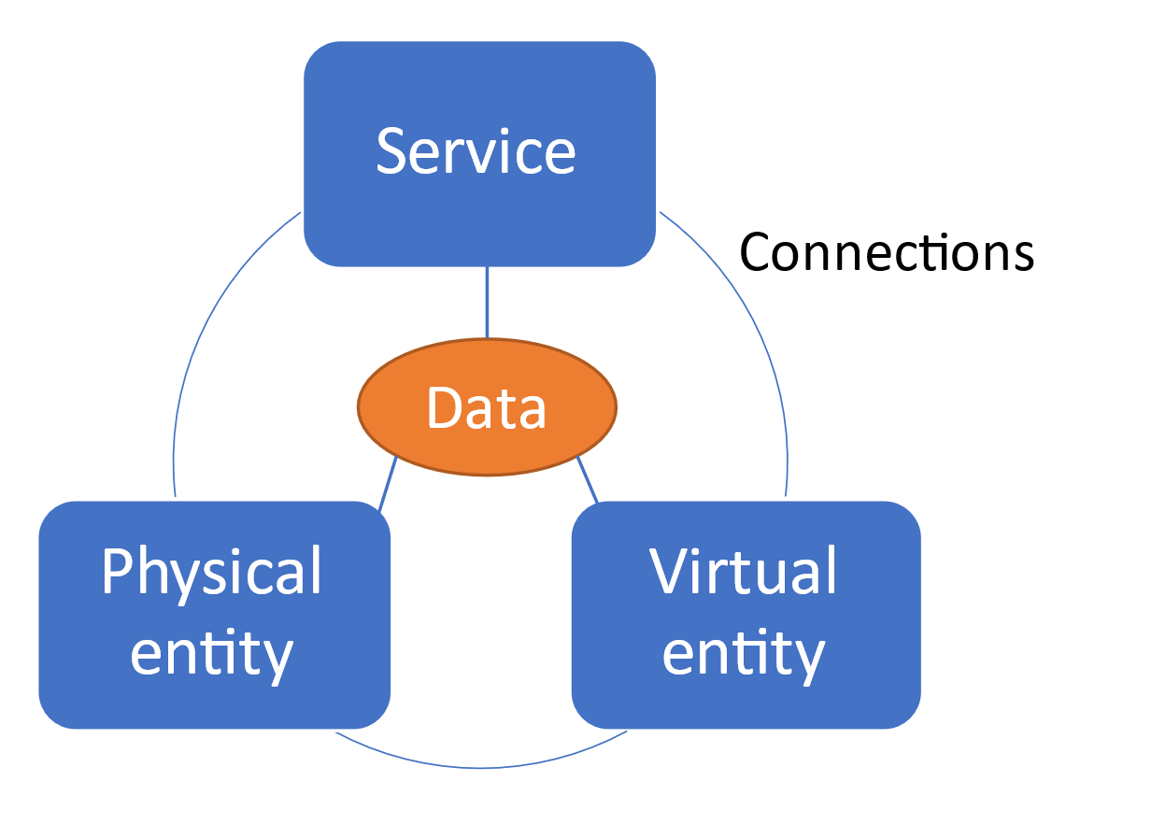
Digital twin
Reference model
Notes:
Physical entity (PE): A collection of sensors and equipment working collaboratively to collect real-time data for the intended services, meanwhile receiving control orders from the virtual world.
Virtual entity (VE): A digital mirror, that contains models simulating the physical counterpart with high fidelity. Calibration strategies are generated through comparing the models with entities to support models’ evolution.
Services: Provides various services to support the management and control of PEs as well as the operation and evolution of VEs. Services are usually requested by the users to fulfill certain functionalities.
Data: A shared storage consisting of the raw data from PEs, VEs, and services. It may also be responsible for merging data from various sources to a fused format.
Connections: The connections for all four of the above-mentioned dimensions. Relevant concepts include communication

Slide 9
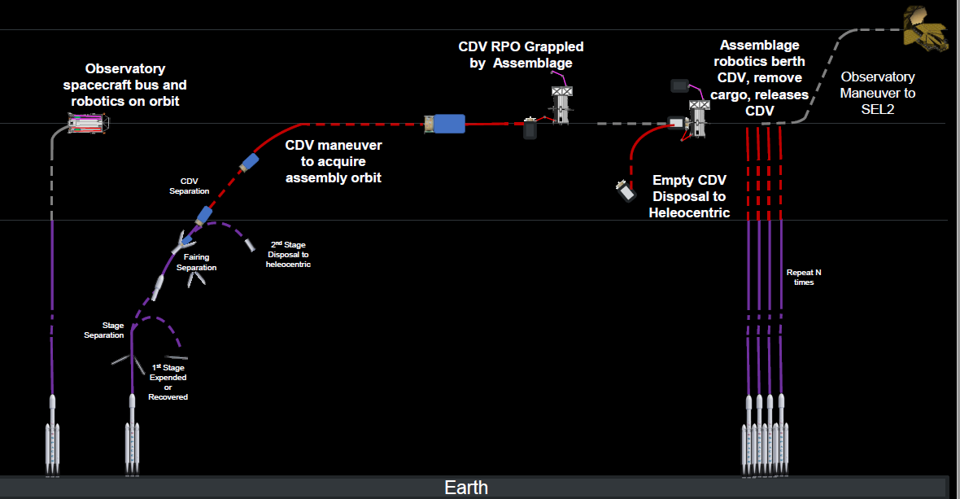
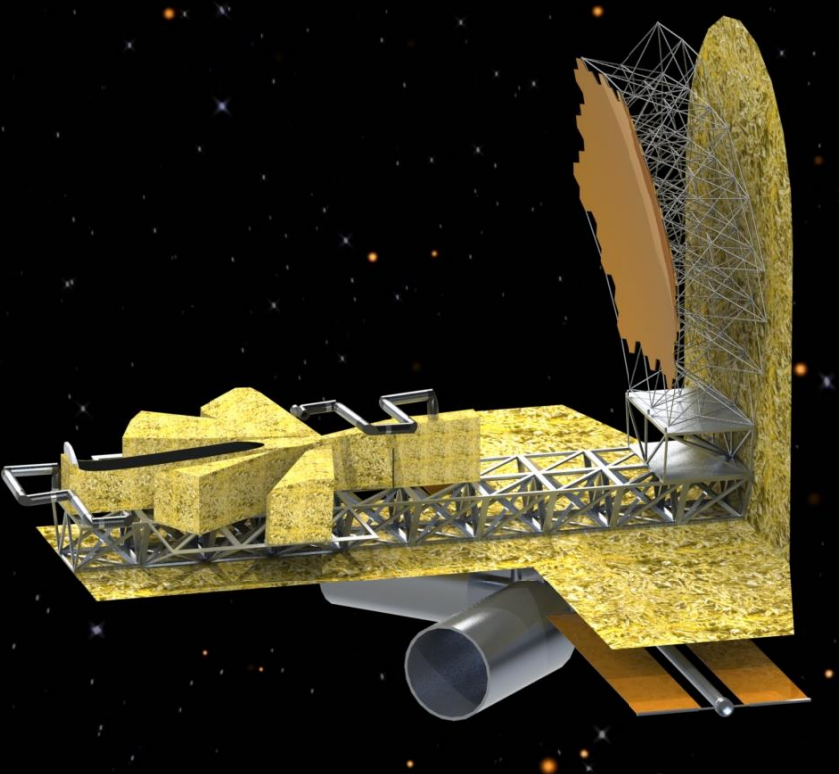
Application - Aerospace
Notes:
NASA in-Space Assembled Telescope (iSAT) Study

Slide 10
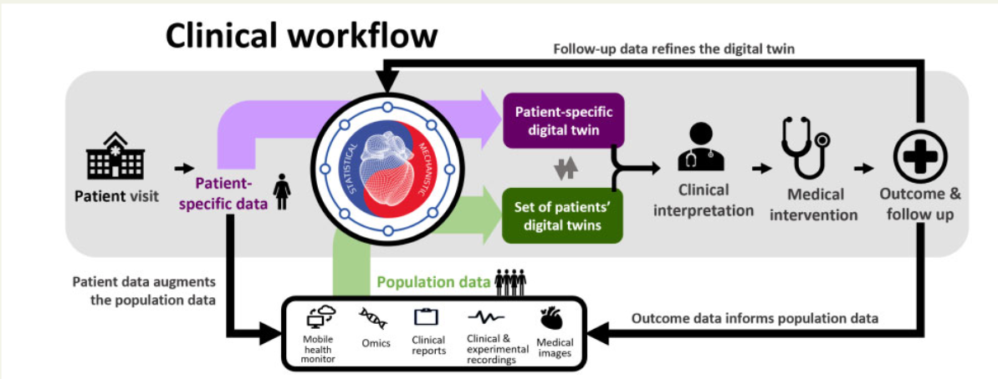
Application - Healthcare
Notes:
Corral-Acero, J., Margara, F., Marciniak, M., Rodero, C., Loncaric, F., Feng, Y., Gilbert, A., Fernandes, J. F., Bukhari, H. A., Wajdan, A., Martinez, M. V., Santos, M. S., Shamohammdi, M., Luo, H., Westphal, P., Leeson, P., DiAchille, P., Gurev, V., Mayr, M., … Lamata, P. (2020). The ‘Digital Twin’ to enable the vision of precision cardiology. European Heart Journal, 41(48), 4556–4564. https://doi.org/10.1093/eurheartj/ehaa159

Slide 11
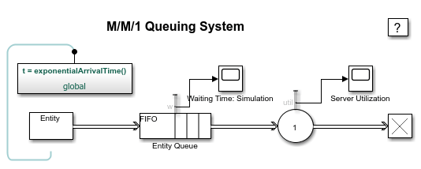


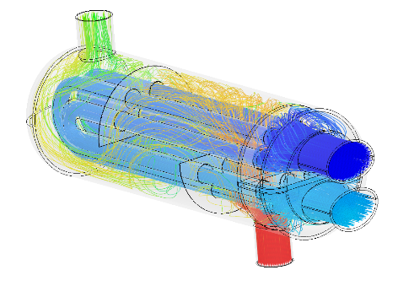

Challenges
Different MoCs
Other differences
Units
Fidelities
Communication patterns
...
Different vendors

Slide 12
Research topic
Explore frameworks to integrate and manage the tools and models which come from various vendors along with different paradigms
⇒ Integration and orchestration

Slide 13

Case study: microbrewery
Why?
Process states are easy to observe, e.g., temperature, CO2, …etc.
Conditions are relatively mild, i.e., low temp, medium pressure.
Well studied phenomena ⇒ simple to build
Multiple models adopted to describe the fermentation reactions ⇒ I&O investigation

Slide 14
State of the art
Monitoring
Hard sensors
Soft sensors
Modelling
High level abstraction
Low level abstraction
Controlling
Traditional
Data or Model based
Notes:
Hard sensor: thermostat, pressure gauge, spectroscopy, …etc.
Soft sensor (Inferential sensor): Estimate process variables that cannot be directly measured, by combining data collected from hard sensors into mathematical models, e.g., MultiVariate Data Analysis (MVDA), Artificial Neural Networks (ANN)
High level abstraction: mechanistic models, Computer-Aided Design (CAD), …etc.
Low level abstraction: AI technologies such as machine learning.
Traditional: Proportional–Integral–Derivative (PID)
Model-based: Use massive data income for taking into account the contextual knowledge of the underlying complex process, e.g., Model Predictive Control (MPC)

Slide 15
Related work
Integration methods
Orchestration methods
DTs in bioprocessing

Slide 16
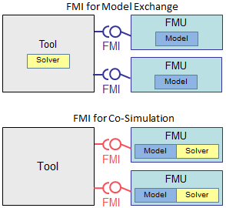
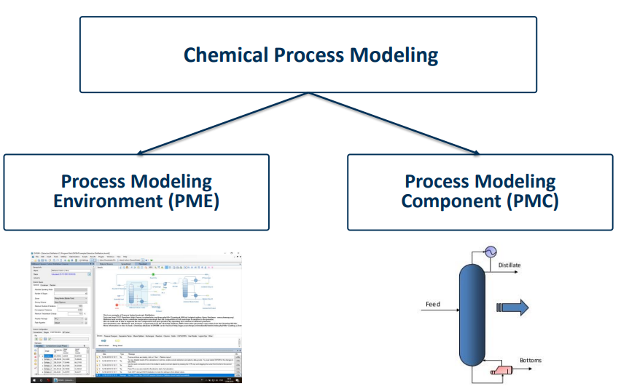
Related work
Integration methods
FMI
CAPE-OPEN
Notes:
The standard can be broadly seen as two parts. The first is Process Modelling Components (PMC), they represent functionally separated building blocks such as thermodynamic and physical properties engines, or numerical solvers that compute highly nonlinear equations which arise from the flowsheet. The second is Process Modelling Environment (PME); it is essentially a flowsheet—a common diagram used by chemical engineers to indicate the general flow of plant processes and equipments—that utilizes services from PMCs, and supposed to handle the related connections seamlessly. CAPE-OPEN compliant simulation programs from different vendors, are able to maintain consistent interoperability without ‘glue codes’ or other manually coded wrappers.
Model Exchange: exposes a numerical algorithm (e.g. ODE) to an external solver of an importer (the simulation environment). Using this solver, the FMU is evaluated at a specific time instant.
Co-Simulation: implements not only the model algorithm, but also the required solution method. The data exchange between FMUs is restricted to discrete communication points, thus the co-simulation algorithm (serving as the master algorithm) is shielded from how individual FMUs advance time internally.

Slide 17
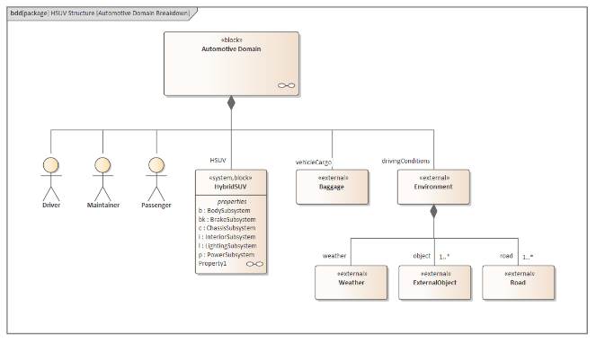
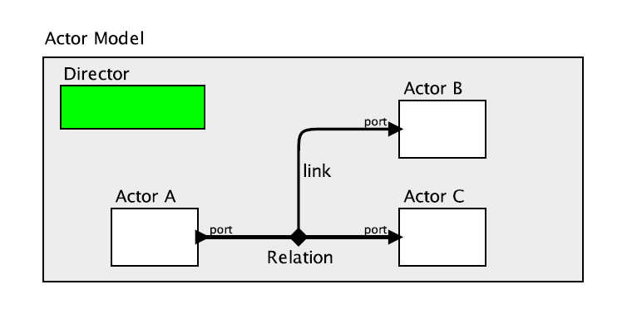
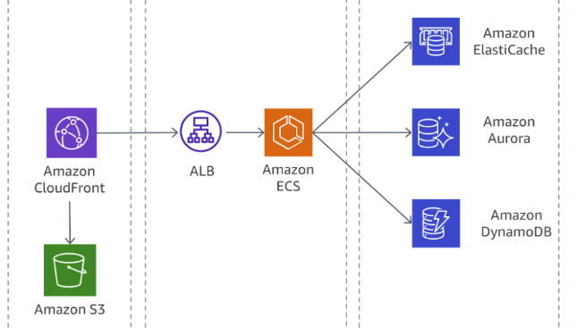
Related work
Orchestration methods
SysML
Ptolemy II
SOA
Notes:
SysML is a dialect of Unified Modeling Language (UML) for MBSE applications. In contrast to Ptolemy II, SysML emphasizes providing rich static and dynamic behavioral information in the form of diagrams. The static diagrams can represent the system structures in varying degrees of transparency, for instance, Block Definition (black-box), Internal Block (white-box) or Requirement (declarative).
Ptolemy II is a framework that coordinates actors of various models of computation (MoC) while maintaining strong semantics of each individual model. The notion of MoC refers to an abstract collection of rules that govern the interaction between components in a design.
SOA. In specific, this approach regards models in DTs as independent cloud-native microservices. The DT is deployed as containers, and orchestrated with off the shelf applications such as Kubernetes. This view of DTs provides the benefits of rapid deployment, as well as auto monitoring, scaling, and load balancing among other features which are found in commercial cloud services. This practice is also suitable for continuous integration (CI). It is important to recognize that since the majority of orchestration is off-loaded to cloud space, the demands of an efficient and reliable networking setup and integration also become significantly higher.

Slide 18
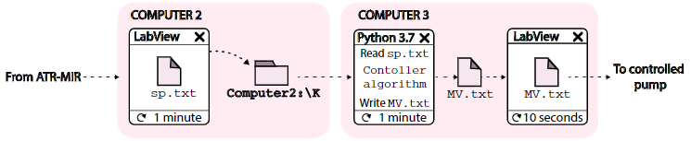
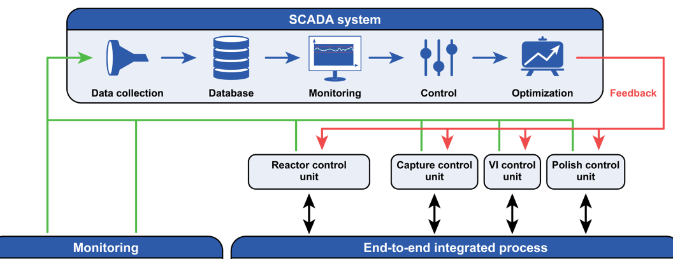
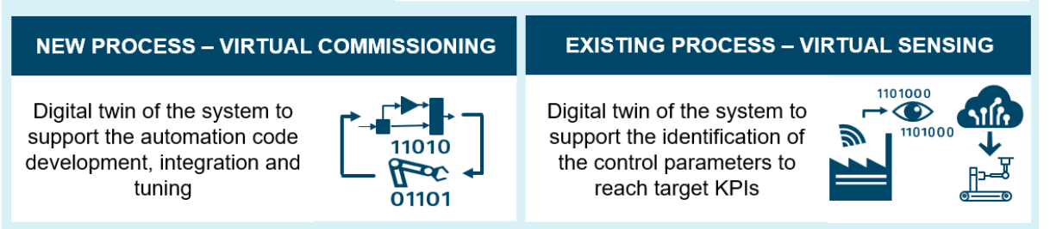
Related work
DTs in bioprocessing
Ethanol fermentation (Lopez 2020)
Antibodies production (Feidl 2019)
Ketchup production (Eppinger 2021)
Notes:
Lopez et al. propose a DT of ethanol fermentation. The researchers use a data-driven soft sensor that takes the online spectroscopy measurements to compute the glucose concentration—referred as process variable (PV)—in real-time. PV is then used as the input to a PID algorithm in order to generate a final control signal—referred as manipulated variable (MV)— that adjusts the feed rate of the controlled pump. The PV-MV transformation in this example showcases how monitoring models and controlling models can be integrated
Feidl et al. manage to build a process-wide control with a SCADA system. The system collects unit-relevant data streams from each process unit, then converts to a centralized data storage, which contextualizes and adds a timestamp to each data point, in which the data is transformed to process-relevant. Afterward, the SCADA system is able to send newly determined setpoints to the respective local control units. Hence, an automated end-to-end integration of the supervisory control with the data acquisition system is achieved.
The ketchup DT firstly obtains the model parameters from historical data through machine learning based intelligent analysis. A hybrid model that combines equation-driven model and data-driven model is then developed before being applying a model order reduction process, such that it can be made compatible with the real-time hard sensors. Once the reduced models are generated, the soft sensors—referred as virtual sensors—can be synthesized and be used to predict the KPIs. Finally, given all available information, the agent of the reinforcement learning algorithm executes actions toward the physical plant and tunes itself with respect to target KPIs by using feedback.

Slide 19
Problem description
Significance of the problem
Problem definition
Proposed services
Research questions

Slide 20
Significance of the problem
# models ↑ ⇒ complexity ↑ ↑
Commercial frameworks are available, but many are locked-in to proprietary IP
Need to build frameworks to support use cases, as well as extracting general insights

Slide 21
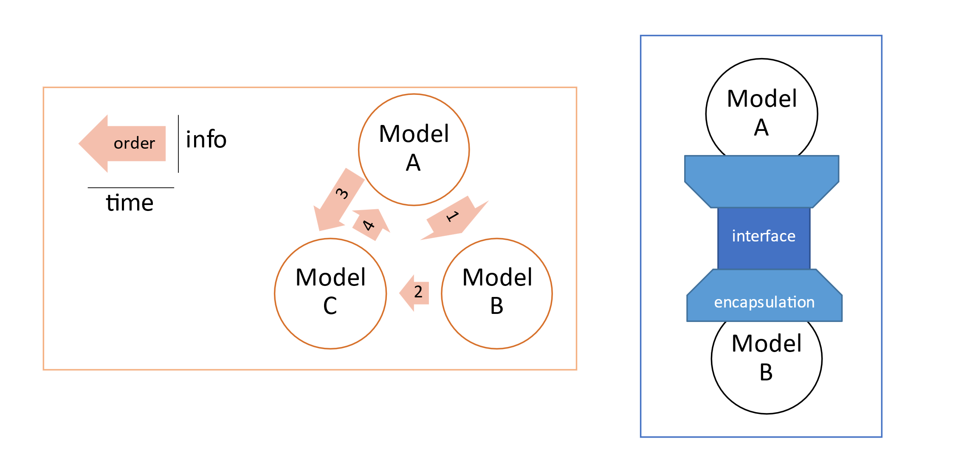
Problem definition
Notes:
Integration couples different models by encapsulating their properties and operations, followed by exchanging the representations in a formatted communication style.
Orchestration dictates models’ sequence of executions and arranges the event queue for the event instances that are triggered by the respective models.

Slide 22
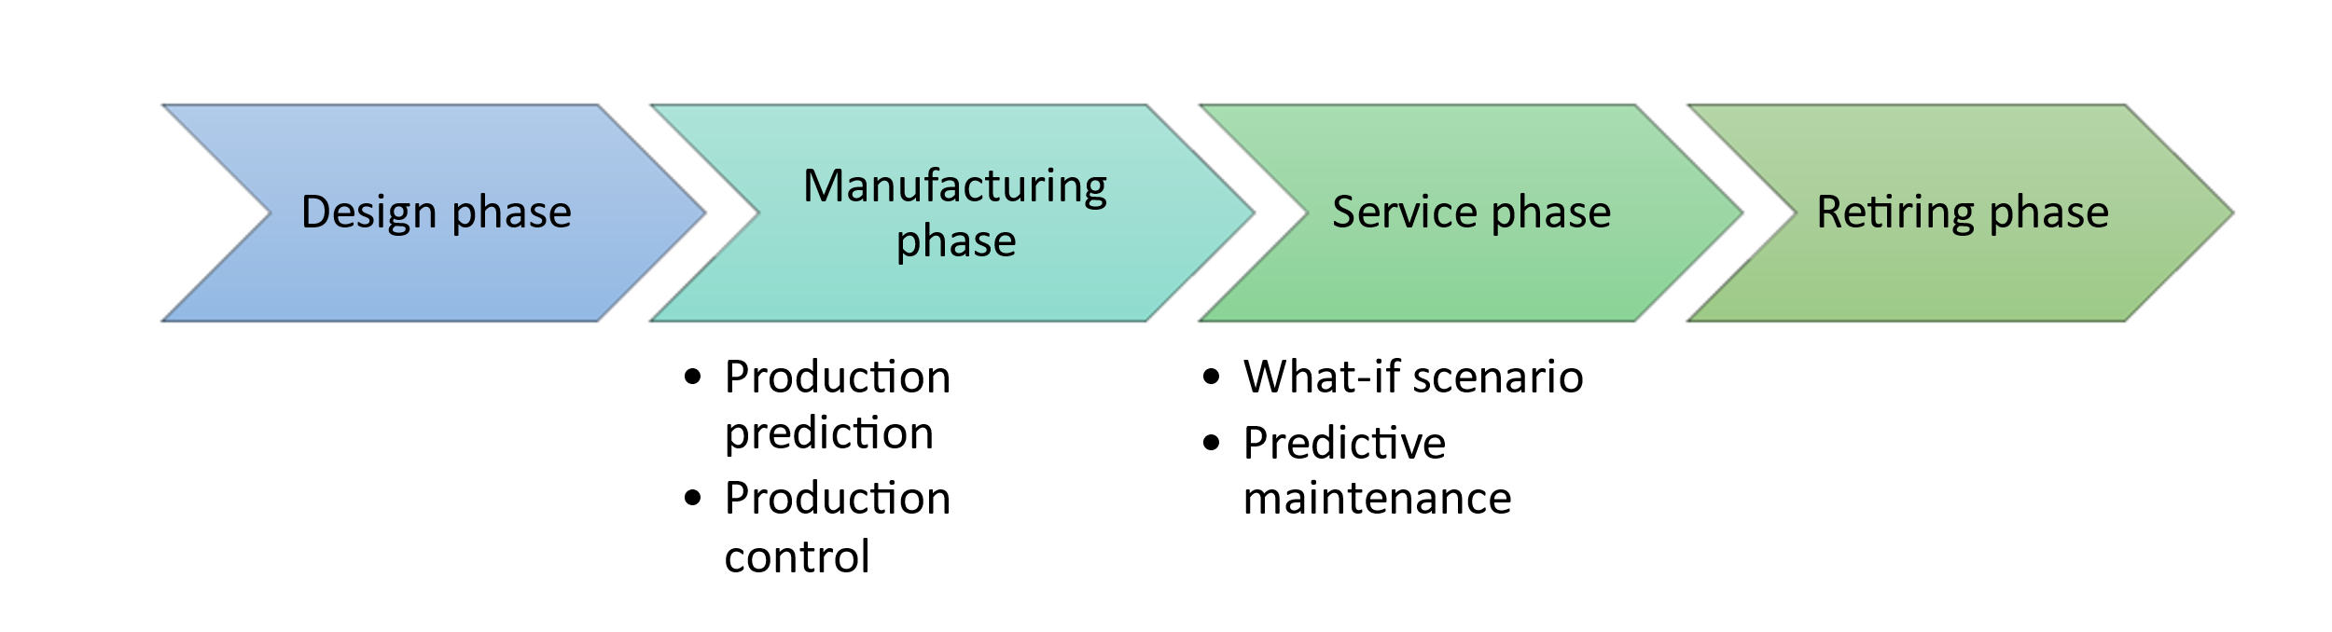
Proposed services
Notes:
Production prediction (S1): predict the properties of end-product and whether its quantity and quality will meet the demand based on the given materials and resources.
Production control (S2): organize the production schedules and regulate the process such that the utilization of resources is optimized.
What-if scenarios (S3): create a hypothetical situation and predict its effect on the production in order to generate variants of the production schedule.
Predictive maintenance (S4): using the data stream from the plant and physical-based modelling to generate a prognosis of the remaining lifetime of plant components.
The design phase encompasses the designs of product, process, and plant, in increasing order of scale.
The manufacturing phase concerns goods production, and the internal logistical affairs involved. S1 and S2 primarily deal with the questions of artifact quantity as well as the strategies to optimize the quantity. Therefore, they are considered to be in the manufacturing phase.
The service phase includes external logistics, user experiences; the detection of anomalies, and repairs. S3 and S4 are deemed to belong in this category.
In the retiring phase, decommissioning of the product is dealt with. Valuable data and parts can be obtained from this recycling action so as to improve the future lifecycles.

Slide 23
Research questions
What are the key ingredients for integration and orchestration of models in different services for a microbrewery DT?
How can these ingredients be generalized to benefit other industry fields?
What framework is suitable to support these ingredients?

Slide 24
Methodology
Approach
Project steps
Framework overviews

Slide 25
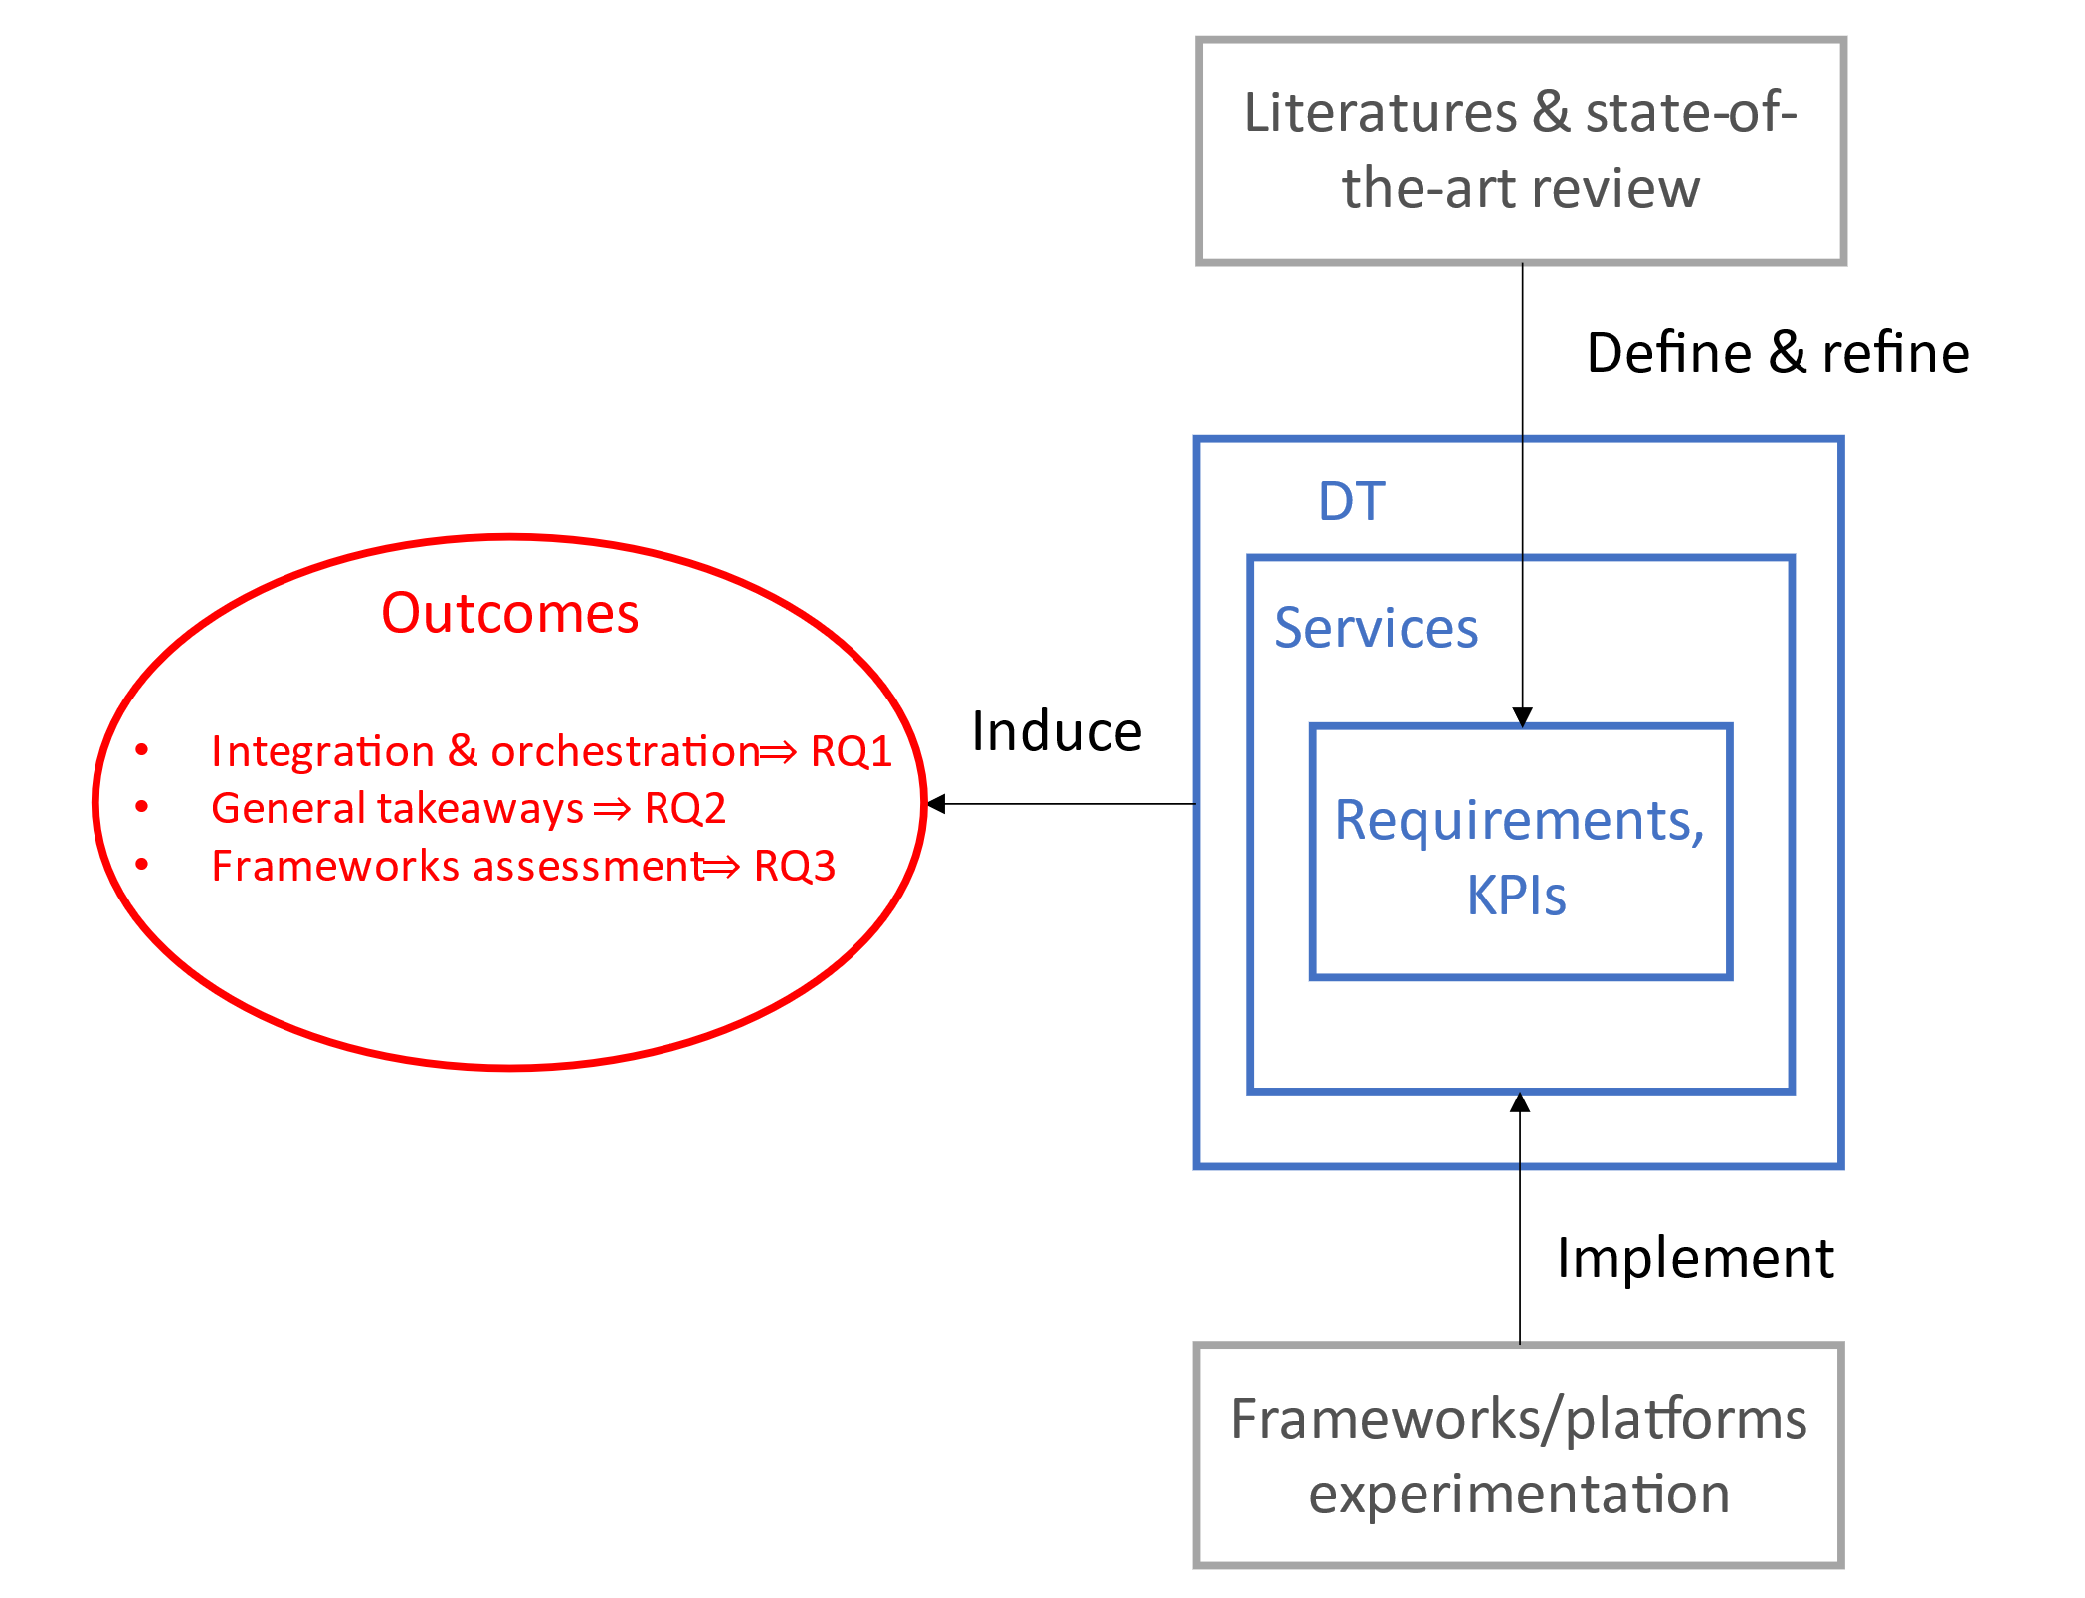
Approach

Slide 26
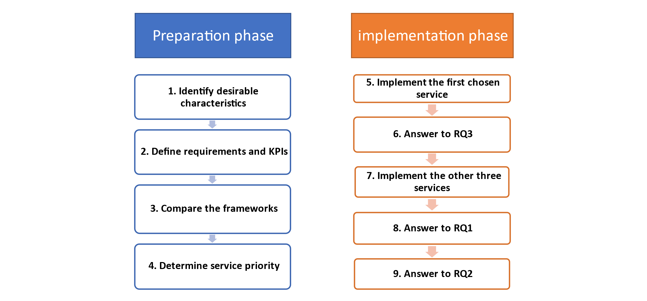
Project steps

Slide 27
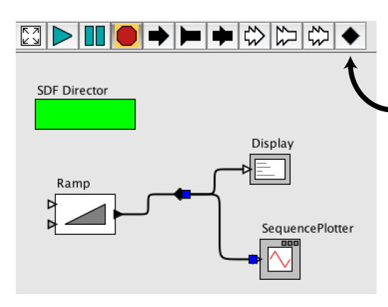





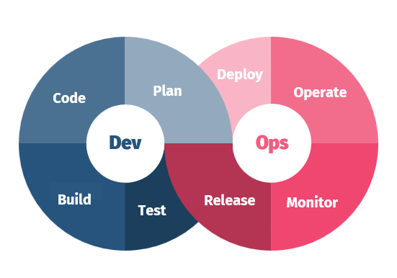

Framework overview
M2M network
Ptolemy II
TwinOps
Notes:
When applied to DT construction, one can map the physical entities to M2M client objects (bootstrapping, registration), and the virtual entities to M2M server objects (resource management). The idea is to leverage the protocol to perform the necessary integration and orchestration.
Four subclass of NamedObjThese are called Attribute, Entity, Port, and Relation. The Relation class represents communication path between entities. The Port class has links to Relation, and it also hosts the Receiver interface that implements methods relating to data transmitting. Together they can be used to manage the model integration in DTs. On the other hand, for orchestration, it can be achieved in the Executable interface which is implemented by Director. The interface coordinates the iterations among actors based on the rules of the selected MoC.
Proposed by Hugues et al. , TwinOps borrows the concept of DevOps from software engineering, where the development and operation are merged into one continuous loop of forward delivery and feedback. In TwinOps, the ‘Dev’ part transcends to DT models integration and target codes generation; and the ‘Ops’ part is overloaded with data collection and analysis in DTs.

Slide 28
Preliminary outcomes
Characteristics identifications
Requirements and KPIs
Framework architecture
Framework comparison

Slide 29
Characteristics identifications
Label | Integration | Label | Orchestration
I1 | Configurability of parameters and time advancement | O1 | Control flow and execution sequence
I2 | Automated code/data generation | O2 | Ontology checking
I3 | Data exchange consistency | O3 | Managing mixed fidelity/granularity
I4 | Plug & play modularity
Notes:
These characteristics reoccur in the remarks which are found in the gathered studies.
I1: First is the adjustability of initialization of the subsystems. As Tolksdorf et al. point out, upon the convergence of sub-models into one flowsheet, process engineers often face the challenge of guessing sensible initial values as the sub-models no longer are transparent to them, and a poor guess can easily lead to underperforming models. Therefore, it is argued that the accessibility to critical parameters throughout the whole process is essential to integration.
I2: refers to the required automation upon combining models in order to reduce human errors. As chemical process optimizations are rarely accomplished by one single program, manually interfacing simulation packages from multiple vendors becomes impractical as soon as the system grows large. A systematic method to generate ‘glue codes’ and data adaptation is an ideal solution. In practice, a hybrid scheme with varying levels of automation to trim down the hand-tuning effort is considered relevant in most cases.
I3 suggests in the case when a variable is transferred from one model to another, it shall retain its structure and its dependency relation with other objects. An important implication of this property occurs when several solvers are working on shared data. If information about algebraic dependencies between outputs and inputs are supplied, the importing tool is able to detect and handle algebraic loops automatically.
I4: implies not only the ease of use for the operator, but also the support for templates and instantiation.
O1: reinforces the importance of effective scheduling. One of the key factors that influences the workflow between models is coupling, that is, how tightly are models intertwining with one another. A loose coupling relation generally requires less complex schedules. One may use strategies such as using an external framework to de-couple a pair of inherently coupled models. Other considerations, such as atomicity, might be required should there be concurrent processes.
O2: discusses ontology, which is the explicit organization of constituent concepts and the relations between those concepts. More specifically, ontology can help to express the intended use of a model. In [41], it is indicated that errors may arise from ontology inconsistencies.
O3 raises attention to the time synchronization and convergence across different models. For instance, merging discrete-time and continuous-time models by techniques of sampling and zero order hold; another example, signaling between time and untimed models.

Slide 30
Requirements and KPIs
S1: production prediction
Label | Requirements
R1 | The model state variables shall be validated with real-time empirical data.
R2 | The operator shall be able to configure the initial model parameters based on the given materials and resources.
R3 | The model parameters shall be automatically updated based on the latest real-time data.
R4 | The model may be interrogated for its past instances in order to optimize its present parameters.
Label | KPI
KPI1 | Rate of convergence
KPI2 | Latency
KPI3 | Data availability
KPI4 | Reconfigurability
Notes:
KPI1: How fast the error of prediction against real-world data reaches an accepted lower threshold.
KPI2: How far is the model time behind real-world time.
KPI3: What is the amount of historical data that is useful in performing prediction.
KPI4: How many parameters need to be set at startup time, and how many can be adjusted during runtime.

Slide 31
Requirements and KPIs
S2:
Label | Requirements
R1 | The model optimization may be triggered on the detected disturbance, time, or plant-wide performance.
R2 | The controller calibration may be triggered on time, or state variables deviation.
R3 | The model shall ensure that the calibrations comply with the controller’s desired operating range.
Label | KPI
KPI1 | Stableness of transitory behaviors
KPI2 | System timeliness
Notes:
KPI1: How long is the overshoots or undershoots period occurring before steady state.
KPI2: What is the response time of triggering.

Slide 32
Requirements and KPIs
S3:
Label | Requirements
R1 | The scenario-dependent data shall be stored and handled separately from the master data.
R2 | The scenarios shall be readily applied, reset, and removed without affecting the master schedule.
R3 | The iterations of scenario may be managed under version control.
Label | KPI
KPI1 | Scalability
KPI2 | Accessibility
KPI3 | Modularity
Notes:
KPI1: To what extent are the additional space and time bounded.
KPI2: Are the model instances of the scenarios easily accessible to the operator.
KPI3: Is changeover of the setup for each scenario easily adaptable.

Slide 33
Requirements and KPIs
S4:
Label | Requirements
R1 | Dynamic data acquisition shall used to update the static attributes in the predictive model
R2 | Real-time measurements and simulated results shall be used in the retrofitting of the predictive model
R3 | Data ownership shall have high degree of flexibility and be transferable within the DT in order to perform efficient data prepossessing
Label | KPI
KPI1 | Accuracy
KPI2 | Impact of missing data
KPI3 | Data quality
Notes:
KPI1: What is the error of the predictive model against real-world measurement
KPI2: How missing data may affect the overall performance of predictive model
KPI3: Data quality How much volume, variety, and veracity of the data is lost as the result of transferring and fusion

Slide 34
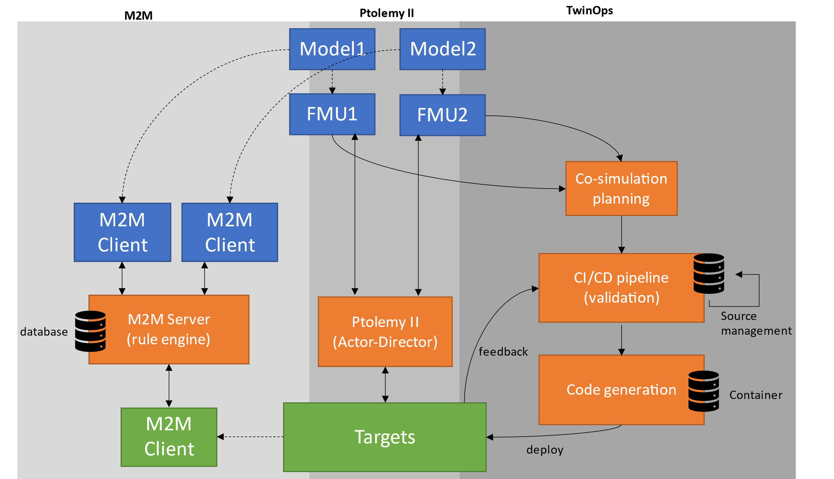
Framework architecture
Notes:
blue: VE
orange: Service
green: PE
cylinder: Data
dash arrow: abstraction
solid arrow: communication

Slide 35
Framework comparison
Architectural view
Scheduling mechanism
Communication strategy
Data storage strategy
Notes:
Architectural view: In Ptolemy II it is enabled by its self-explanatory graphical modeling environment, along with some limited capability of model error checking. In an use case of TwinOps, SysML is adopted for describing the models architecture. Further, it leverages on AADL to refine the more detailed component parts. In M2M there is no specified way of achieving model description.
Scheduling mechanism: In Ptolemy II there are built-in MoCs and sophisticated receiver queues, for instance, FIFO or LIFO implementations, that are able to support this aspect. In TwinOps it utilize the FMI approach, such that the master algorithm is made in AADL, which then be used to orchestrate the FMUs. M2M can adopt some control scheme and the option to place objects in logical group in its protocol specification.
Communication strategy: Ptolemy II has predefined ‘relation’ and ‘port’ object to handle it, however, a potential shortcoming is that entities must be transformed to actors in order to work compatibly. In TwinOps, the detailed connection paths are modeled in AADL, then the pipeline will generate containerized binaries to specific targets. In M2M one can adopt various common common IoT strategies such as client/server (e.g., HTTP), pub/sub (e.g., MQTT) to achieve data communication.
Data storage strategy: In Ptolemy II there are few remarks about logging. TwinOps describes the usage of Azure IoT platform [64] for the distribution of containers. In M2M it is not specified, but cloud database servers are known to be advantageous in various M2M applications. Building an offline or cloud databasesystem is a sound approach, nevertheless in the DT context automation of version control is considered one of the focuses.

Slide 36
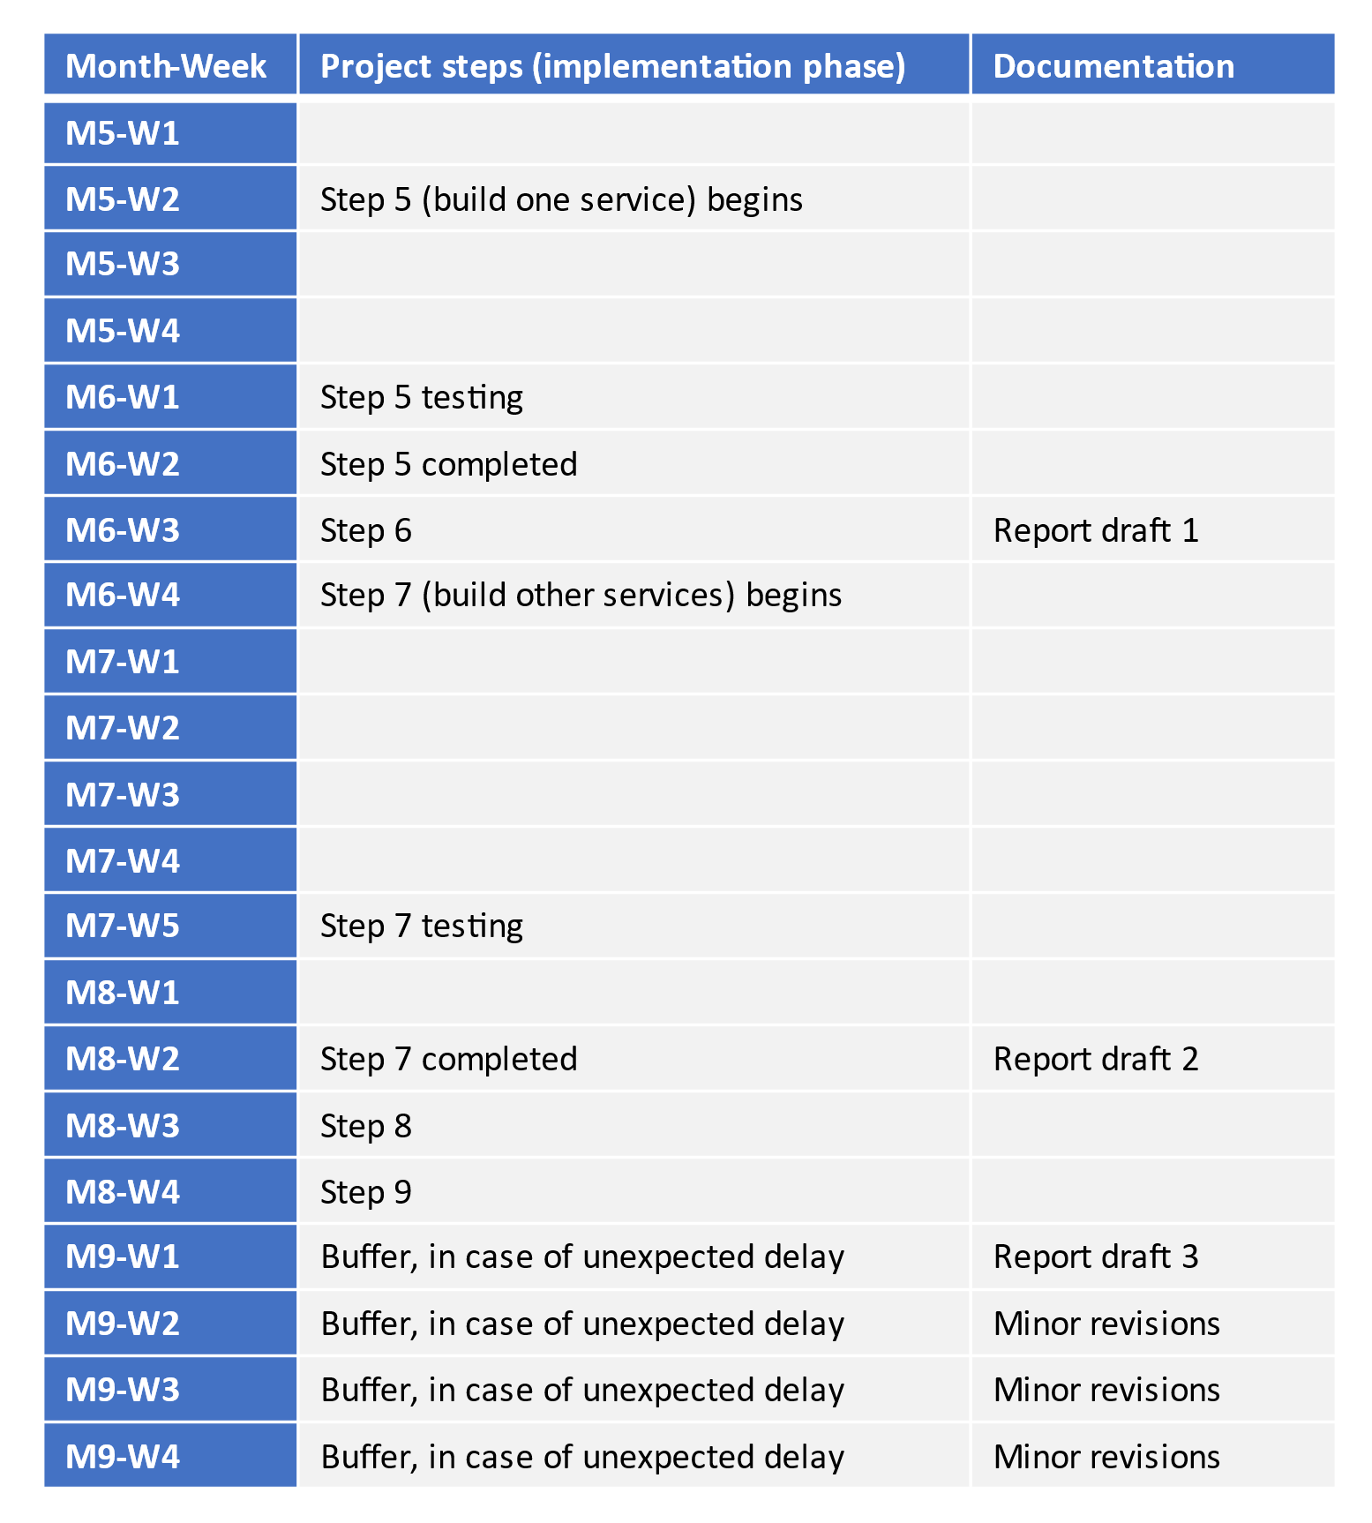
Project timeline

Slide 37
Q&A

Slide 38
Latest progress (supporting materials)
Workflow
TwinOps demo
M2M demo
Ptolemy II meta model

Slide 39
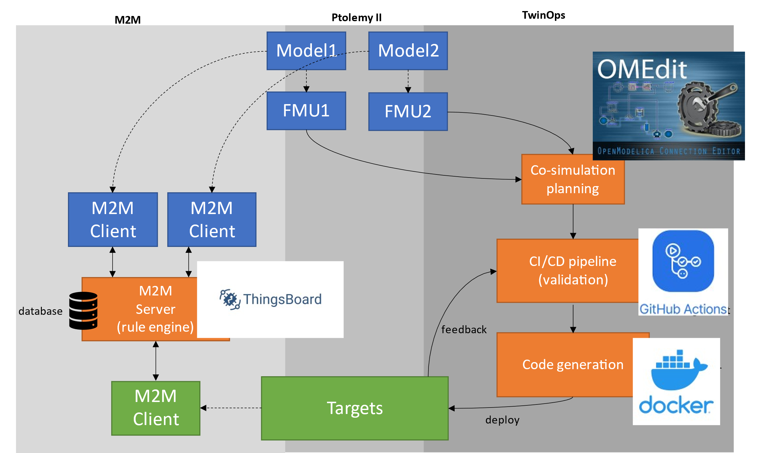
Workflow

Slide 40
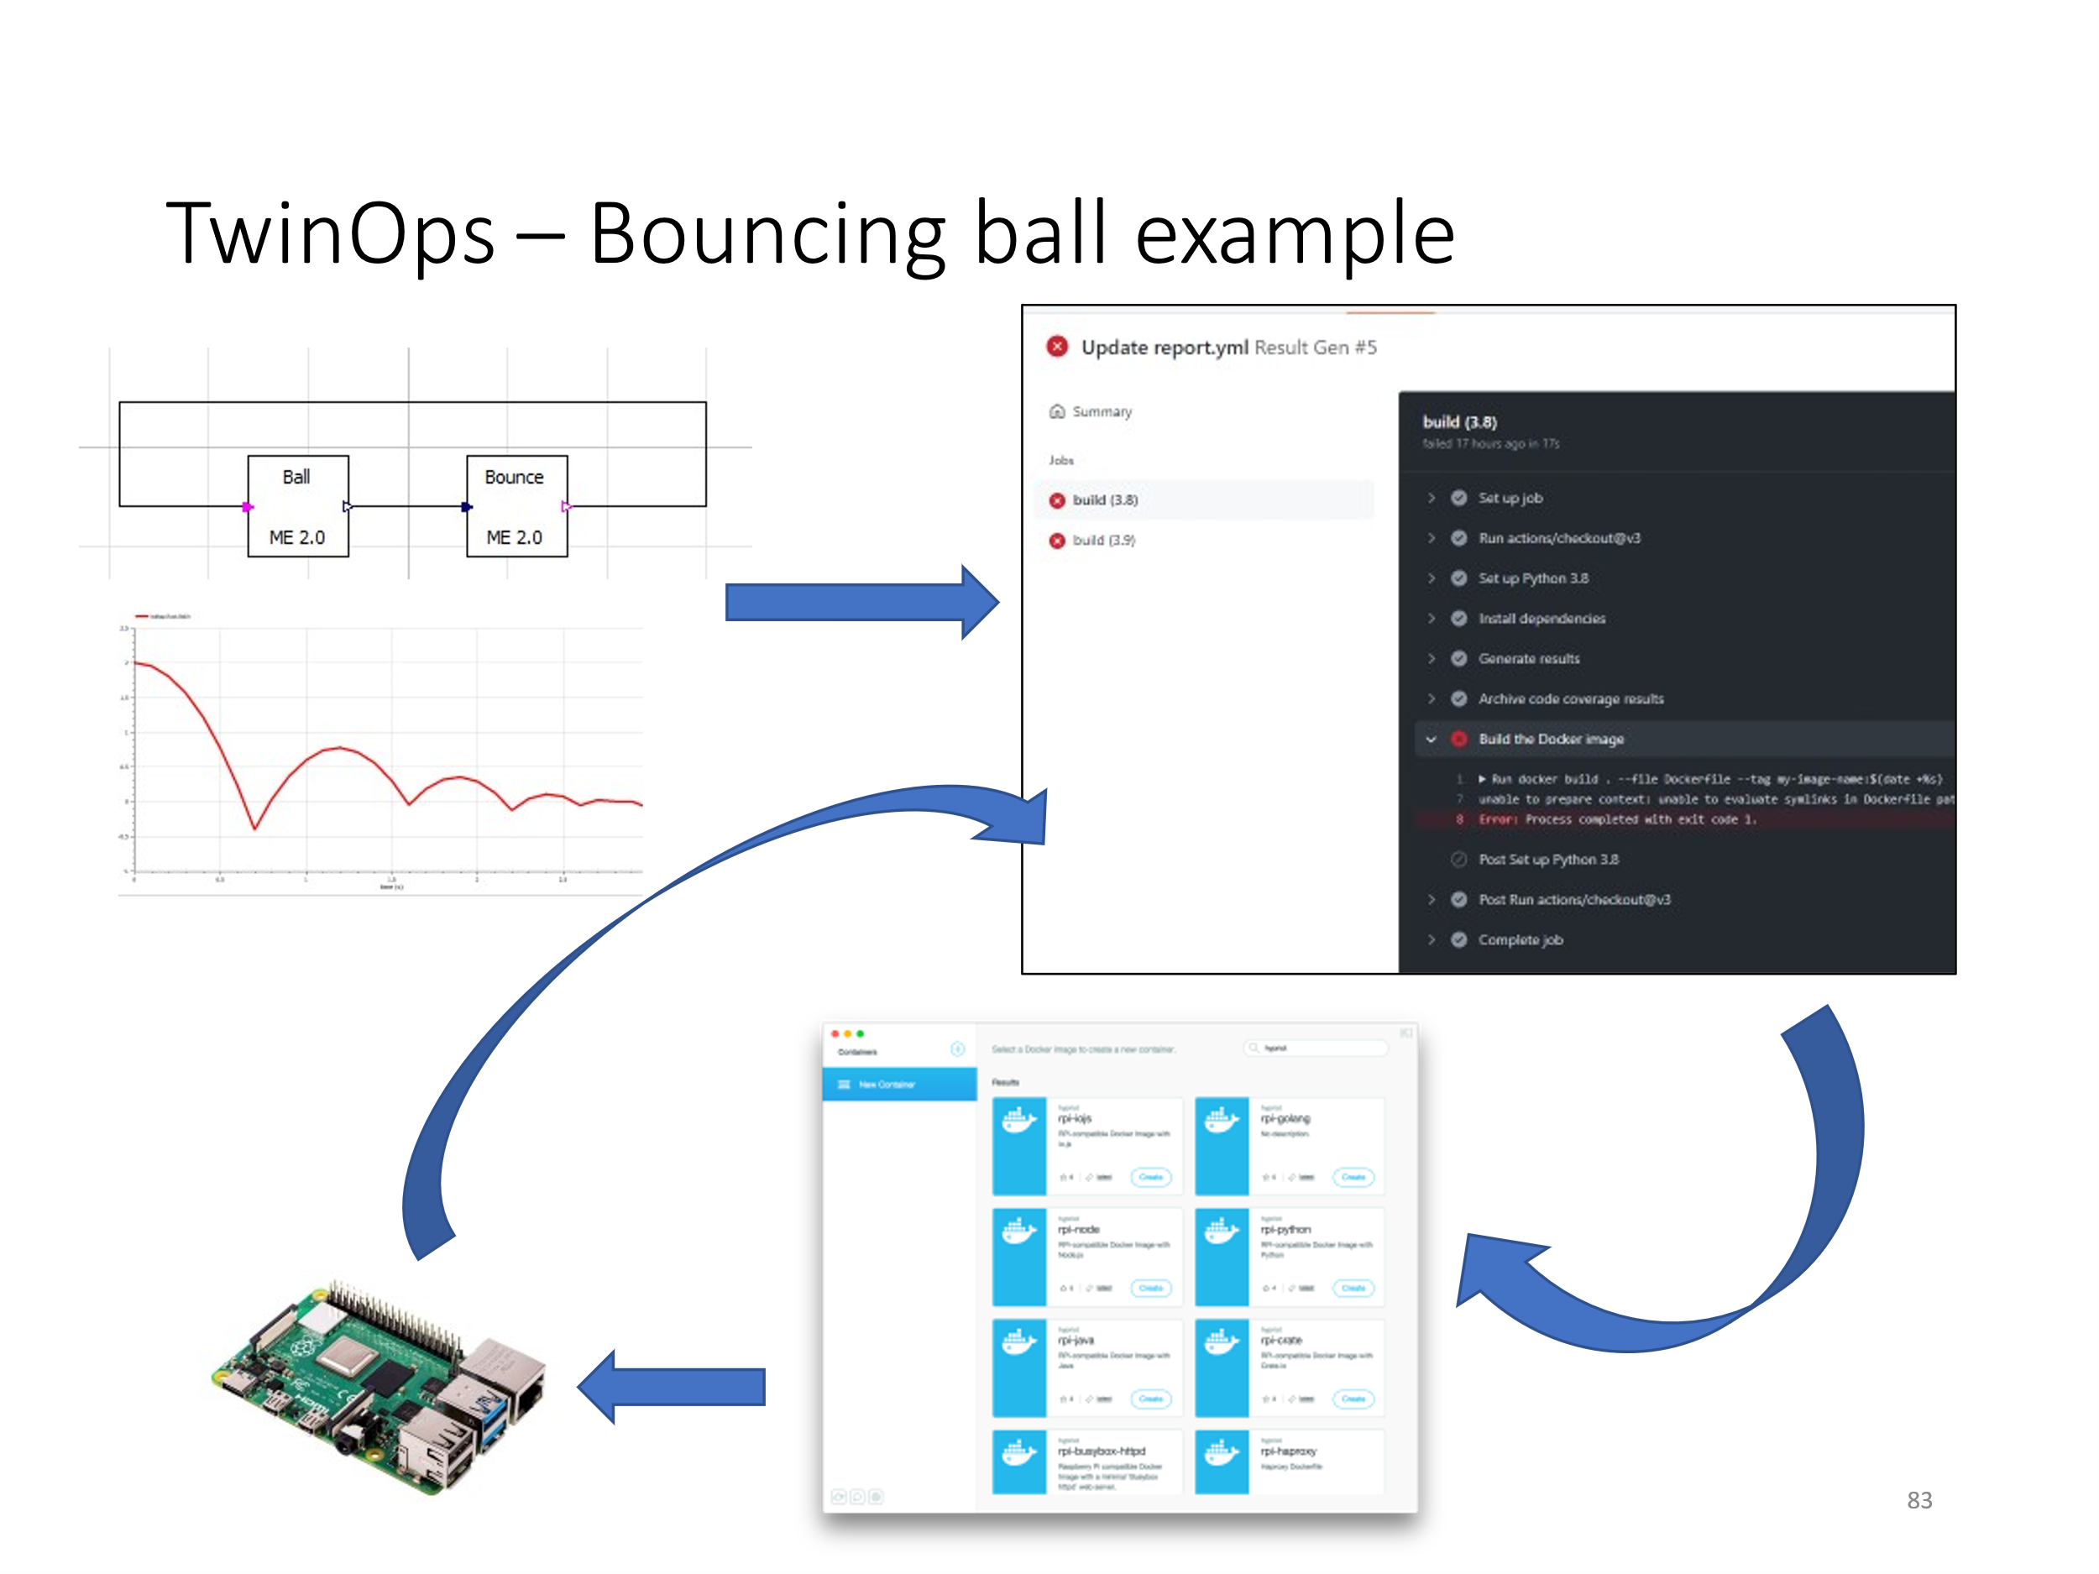
TwinOps demo

Slide 41
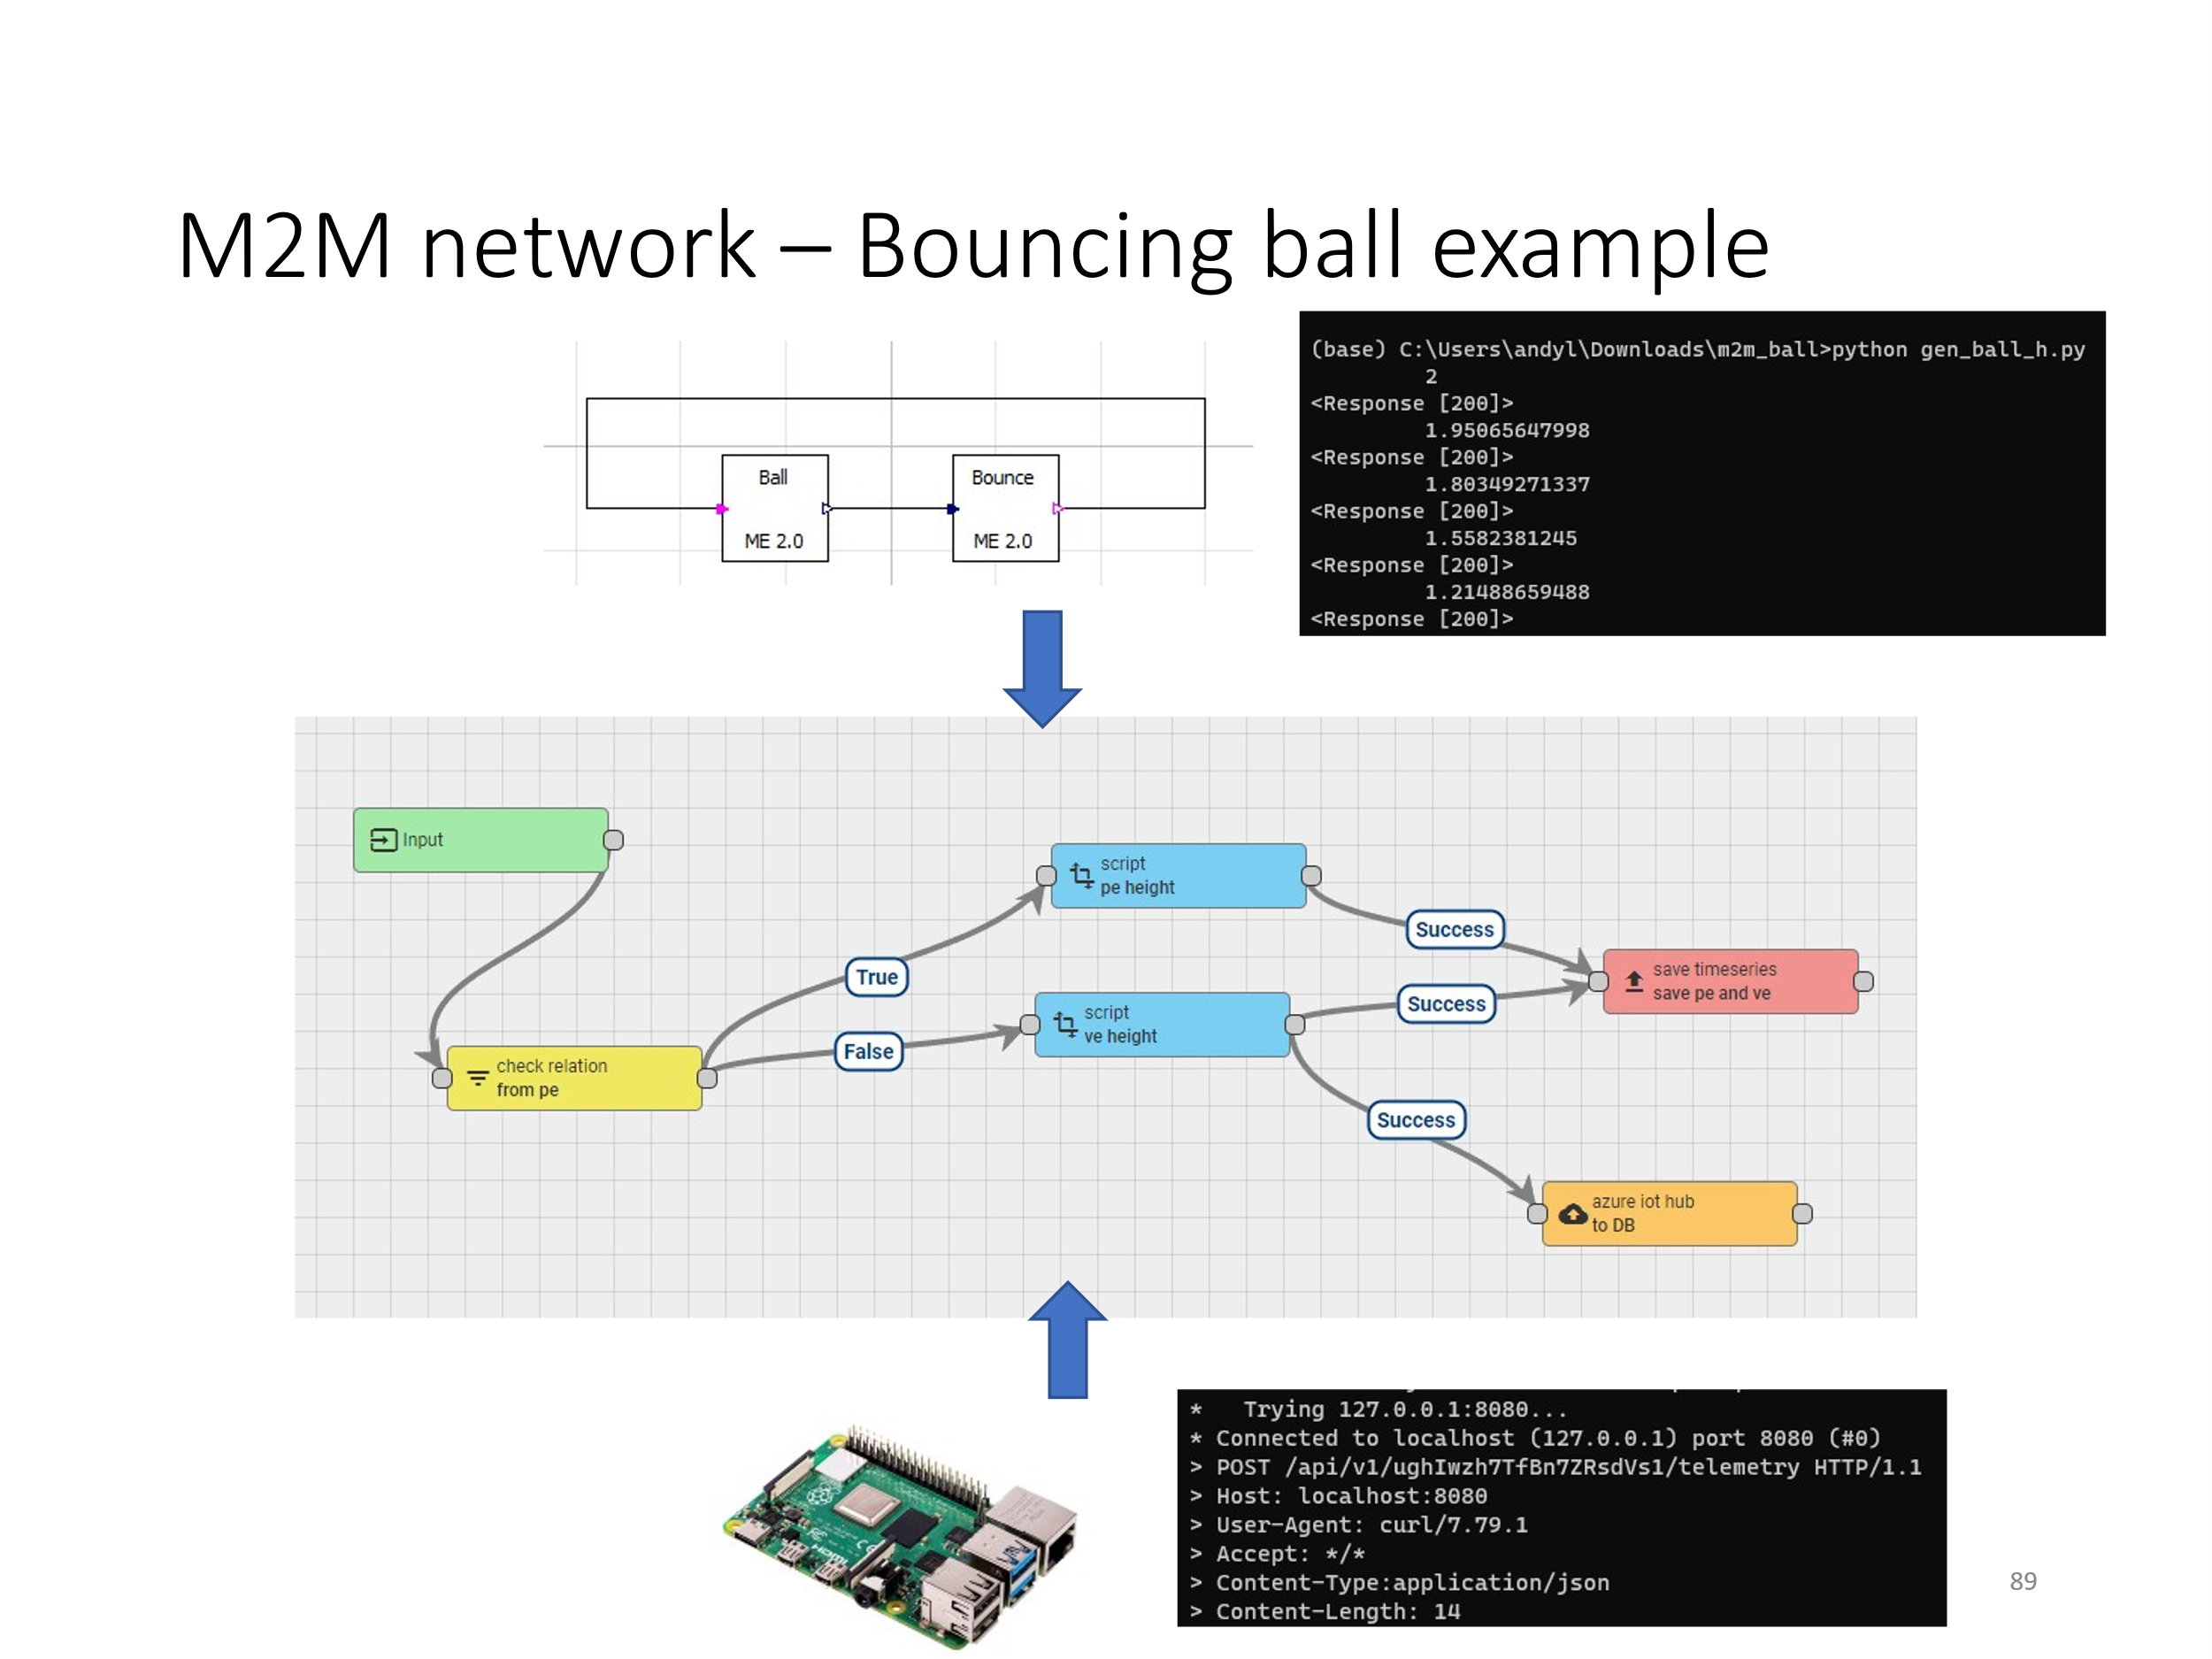
M2M demo

Slide 42
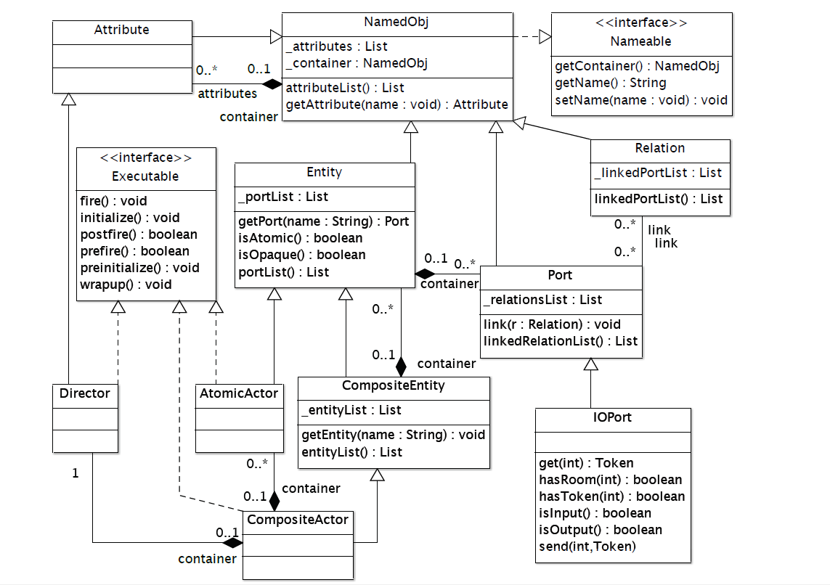
Ptolemy II meta model

